Slide 1
WELCOME TO ENGASJERT 2021-2022!
Vice precident of learning environment
Sara B Beitz
laringsmiljo@stor.uis.no
Notes:
To explain our roles,

Slide 2
PROGRAMME
Getting to know eachother
Contact information
Cooperation agreement
Important dates
Speakers
Trip with engasjert
Input
Notes:
Welcome to the University of Stavanger! You might not know this but once you’re enrolled as a student here at UiS, you are automatically a member of our Student Union StOr. We are a politically independant interest organization that works for all of the students at the University which is you guys!

Slide 3
PROGRAMME
Speakers
Martin – tillitsvalgtordningen
Alva – sis social funds
Una – the student bar
Even Heien – COVID19
Even Hallås – VT
Elisabeth & Kristin - SiS
Notes:
Velkommen til Universitet i Stavanger! Som dere mest sannsynlig ikke vet, så er dere alle nå medlemmer av Studentorganisasjonen ved UiS, StOr. StOr er en politisk uavhengig organisasjon som arbeider for at studentene skal ha det så bra som mulig, ikke bare i undervisningen, men også sosialt. Hva vi gjør skal jeg fortelle mer om i denne presentasjonen.

Slide 4
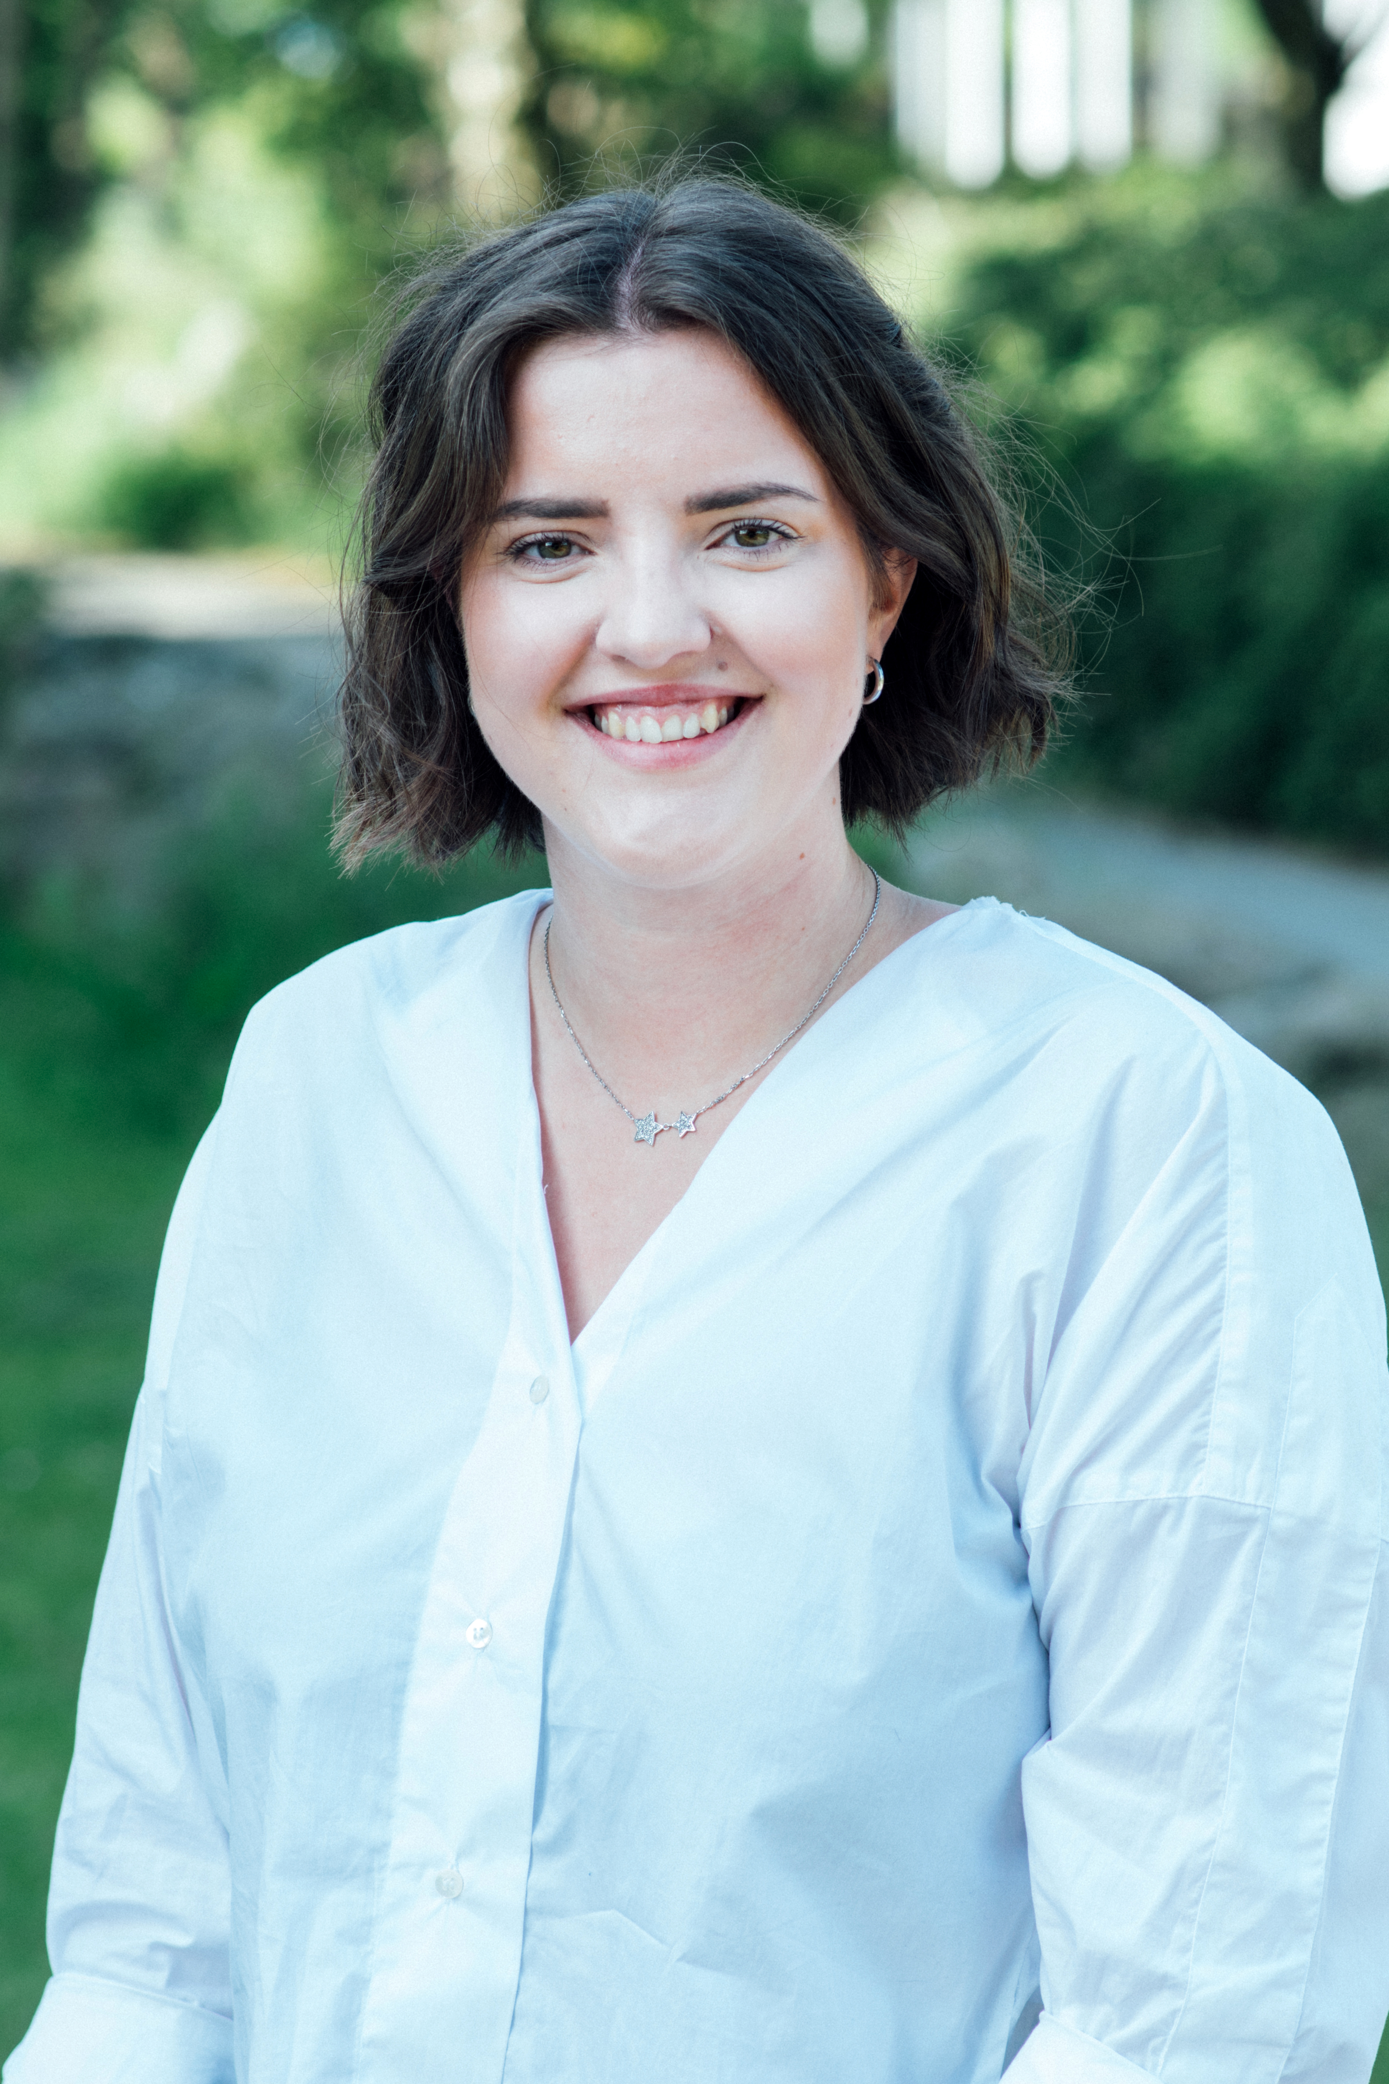
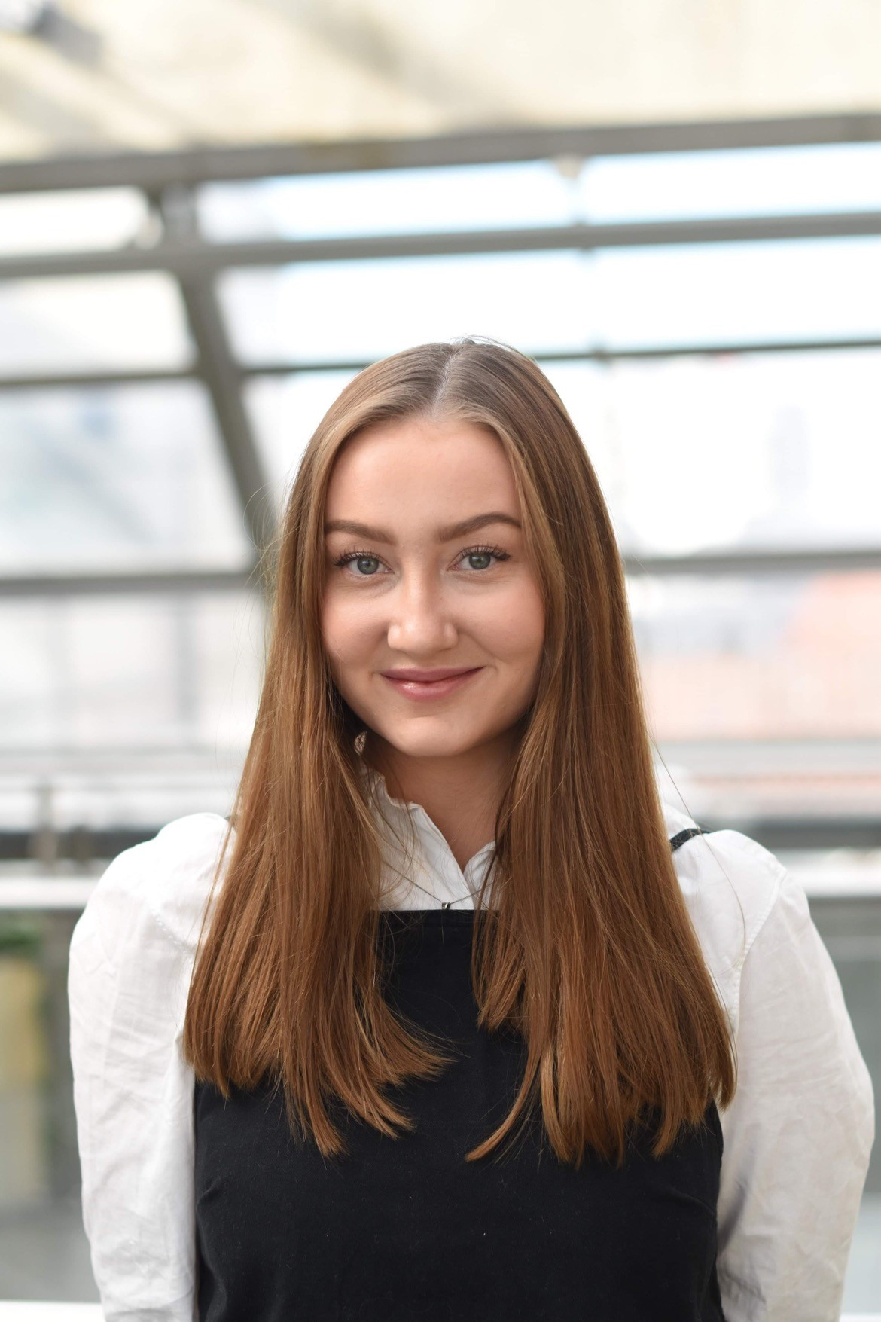
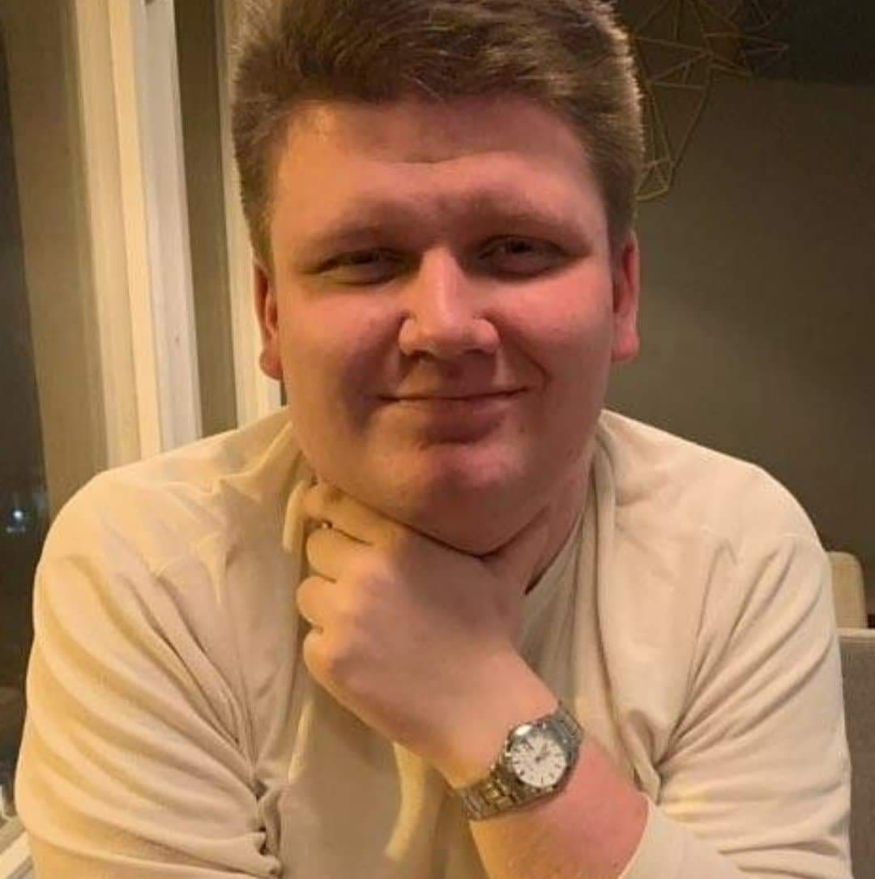
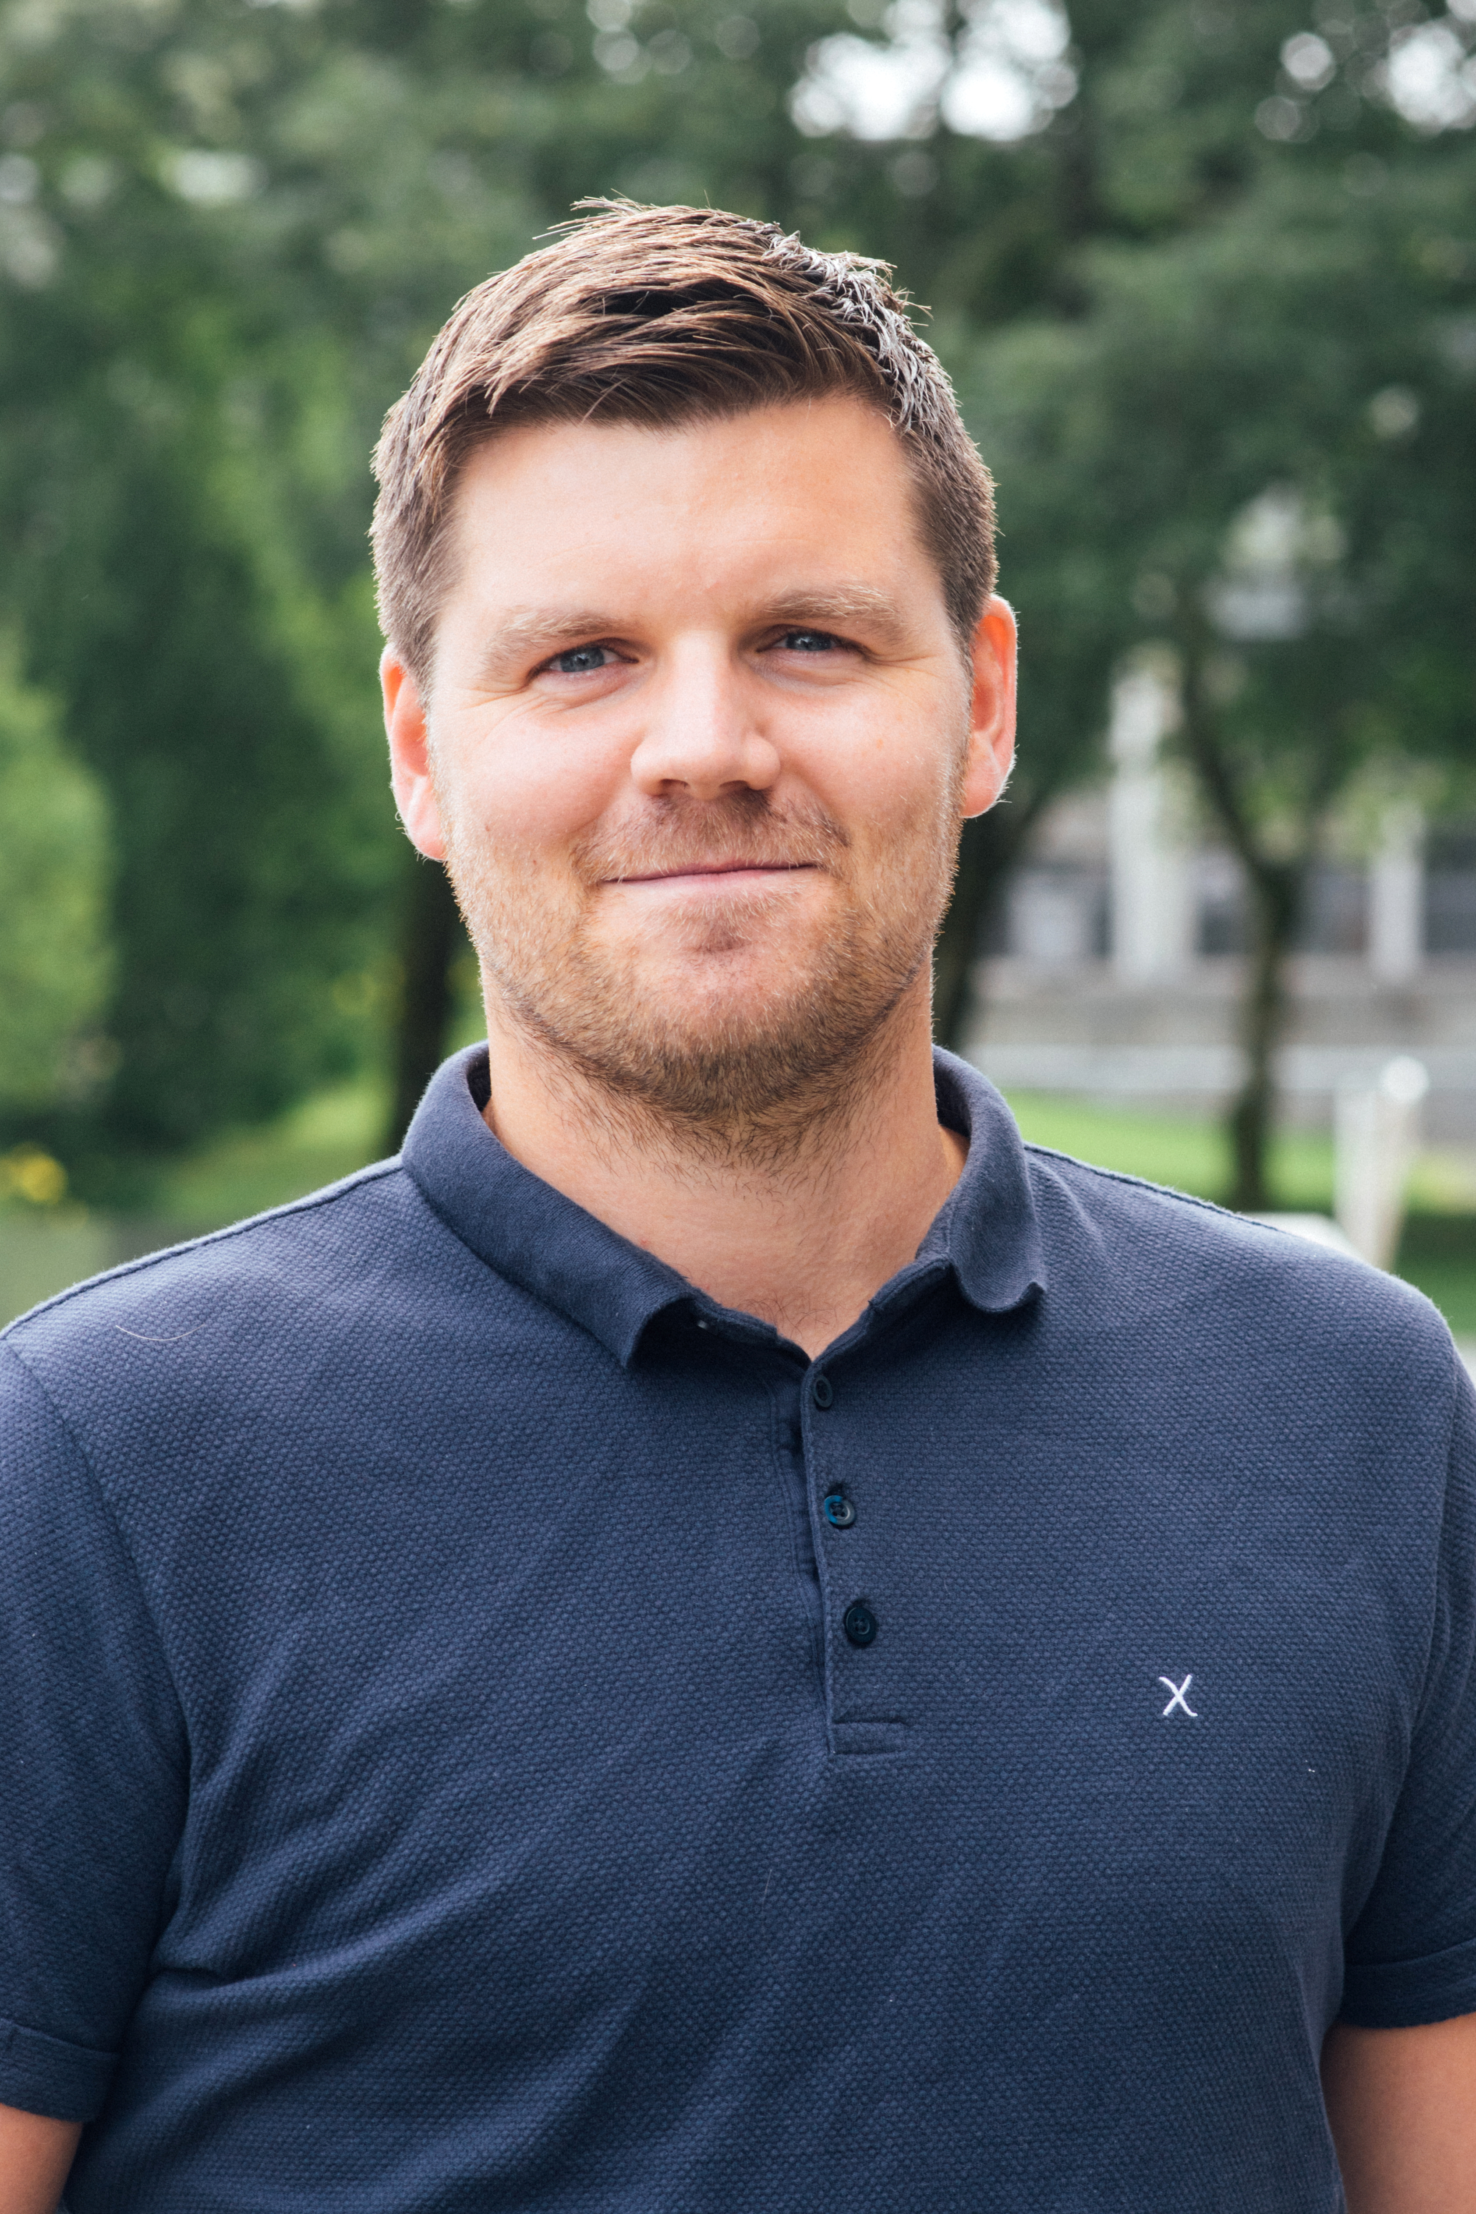
StOr-STYRET
Leder
Eira Aas Eide
leder@stor.uis.no
Nestleder for Læringsmiljø
Sara Bianca Beitz
laringsmiljo@stor.uis.no
Nestleder for Utdanning
Martin Solheim
utdanning@stor.uis.no
Organisasjonskonsulent
Mikael Johnsen
mikael.johnsen@uis.no
Notes:
Philip –
Simen –
Mikael –
Representere Studentorganisasjonen StOr som øverste tillitsvalgt for studentene ved UiS.
Følge opp saker som StOr jobber med som kan være interessante for den generelle student og informere videre om disse.
Påse at det velges studentrepresentanter inn i alle styrer, råd og utvalg i regi av UiS.

Slide 5
TELL US WHO YOU ARE AND WHAT ORGANIZATION YOU’RE FROM

Slide 6
Cooperation Agreement
StOr can allocate spaces for you to work in -desks at SH or classrooms
StOr can profile you on our webpages + other channels such as social media+ infoscreens
Can borrow equipment/rooms and get help to arrange activities on campus
Stands on campus – you have to fill out a form for this through Mikael

Slide 7
Important dates this semester
31. August- 3. September – Sis festival
23.- 25. September – 10 year jubilee studentenes hus
18.-31. Oktober – The student election
4.-10. Oktober – Verdensdagen psykisk helse
Late fall– Trip with engasjert?
November/ desember – Christmas lunch

Slide 8
ELECTIONS 2021-2022
Yes. Your vote does make a difference. Interested in running yourself? Slide into my DM’s!
18-31 october

Slide 9
Contact information
laringsmiljo@stor.uis.no

Slide 10
ABOUT YOU
What we know about linjeforeninger and student organisations
How we can improve
My purpose in this
Is there an interest for raising the sosialt støttefond?

Slide 11
Martin

Slide 12
Alva

Slide 13
Tappetårnet
Is run by 35 volunteers – taking applications!
Open Thursday and Friday
If you want to book an event send an e-mail to: Booking@tappetarnet.no
There you can book events.There is a demand that atleast 25 people need to be there for the bar to open.
TappeTårnet wants to work together with student associations and organizations when it comes to hosting parties such as octoberfest, halloween etc.
Preferably book TT a month in advance.

Slide 14
Even Heien

Slide 15
Even Hallås
e.hallas@stud.uis.no
Funds, 1.oct -21.dec
Demands for organisations
Demands for activities

Slide 16
Elisabeth & Kristin

Slide 17
TRIP WITH ENGASJERT??
How many people want to participate?
Where should we go?

Slide 18
What are your expectations for the engasjert meetings?

Slide 19
INPUT
Norwegian or english?
Too long/ too short?
Themes?

Slide 20
www.Stavangerstudent.no
FACEBOOK
INSTAGRAM
/storuis
@storuis

